Slide 1

Y6 Assessment meeting
April 2026
SATs are a snapshot of your child’s academic results. They have so many more capabilities, gifts and talents. Although we want them to achieve their potential – they do not define them.

Slide 2
What are SATs?
Stand for Statutory Assessments.
Happens nationally at the end of KS2 (Y6).
Assess if pupils are working at, below or above Y6 expectations.
Take the form of tests for reading, spelling & grammar and maths.
Results are reported as Scaled Scores.
Writing is a collection of evidence in books that the children have produced in class.

Slide 3
Scaled Scores explained…
A score of 100 = working at expected standard
Scores below 100 = working below
Scores of 110+ = working at a higher standard

Slide 4
Some children may have qualified for extra time. We have had an external assessor inform us which children need that additional support, and we have made sure it has been in place for all assessments.

Slide 5
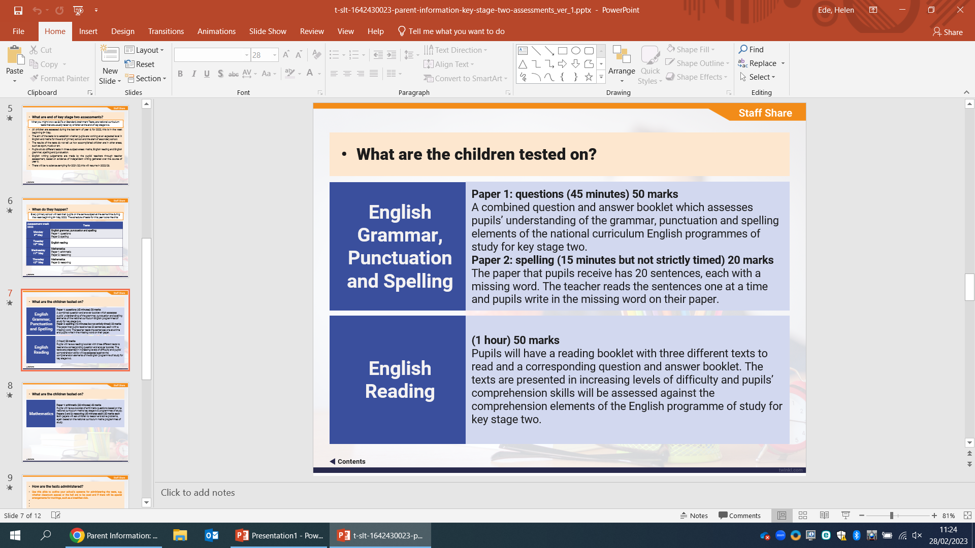

Slide 6
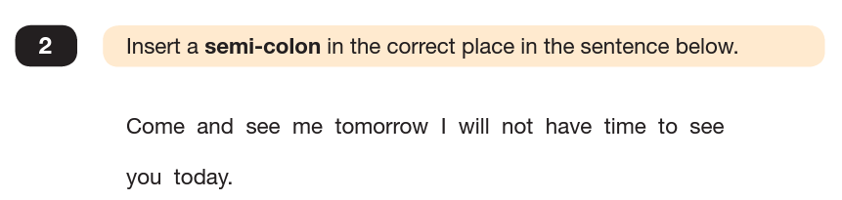
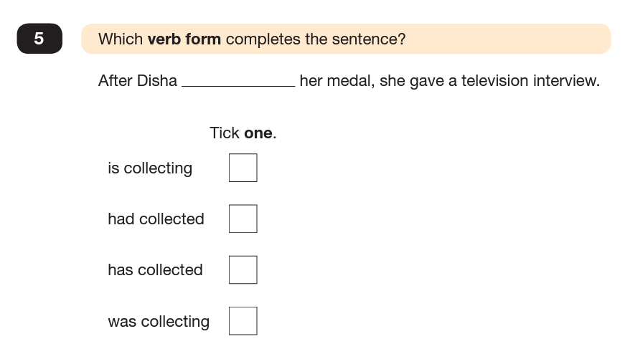
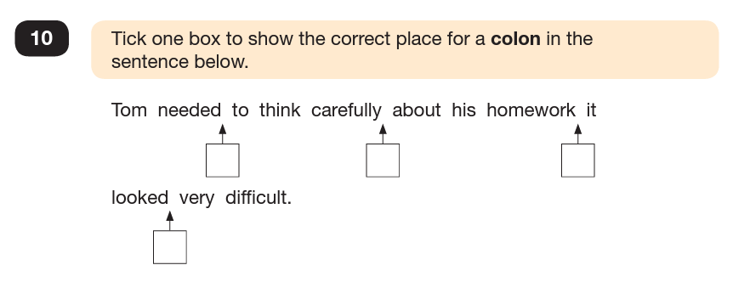
Grammar and Punctuation Paper
Spelling Paper

Slide 8
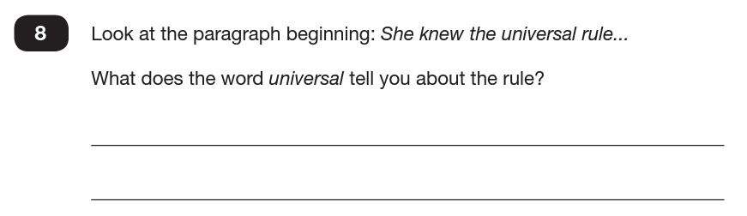
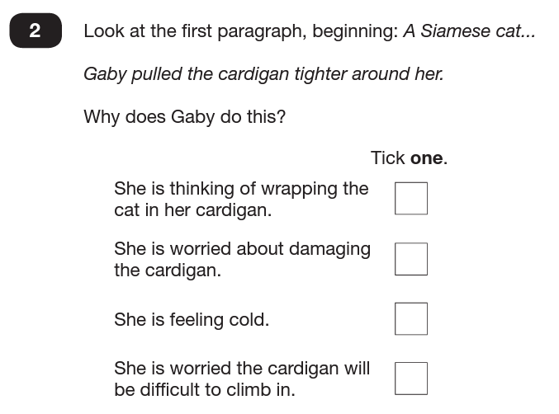
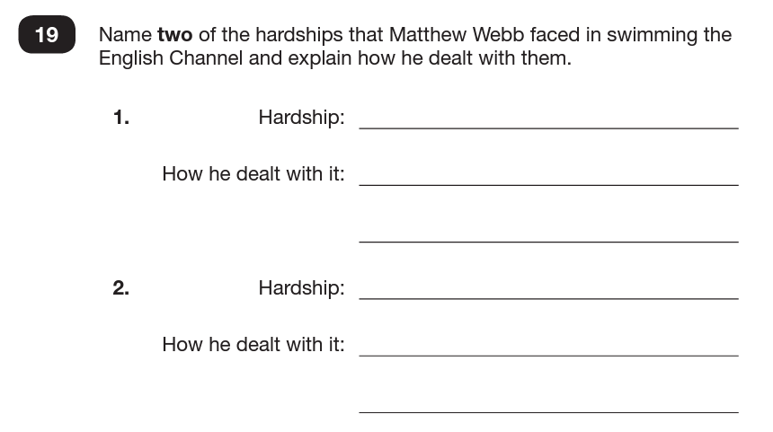

Slide 9
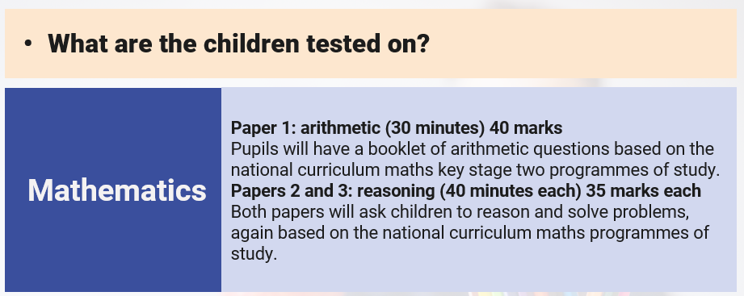

Slide 10
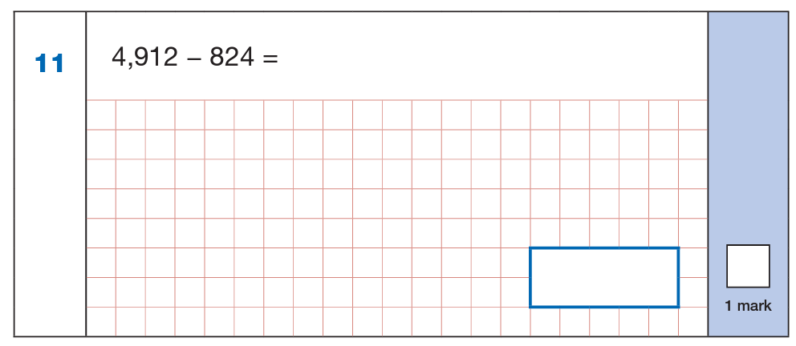
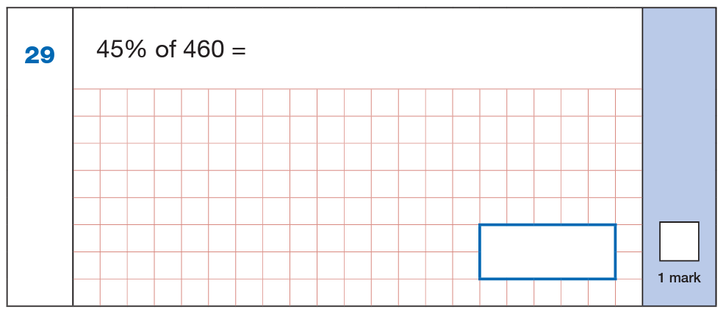
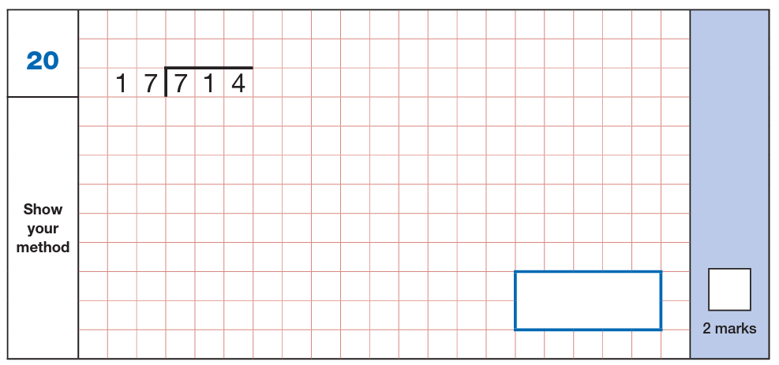
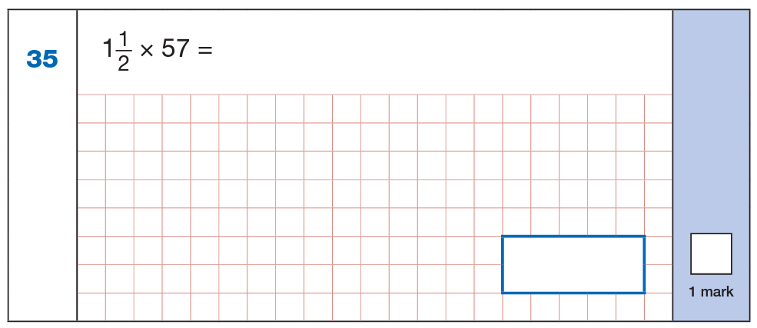

Slide 11
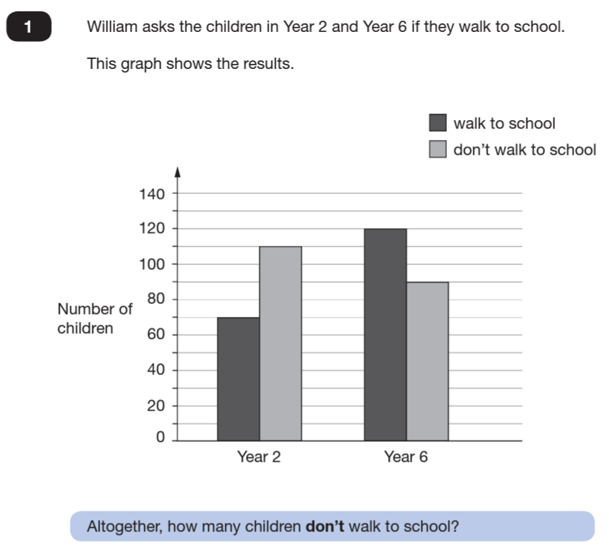
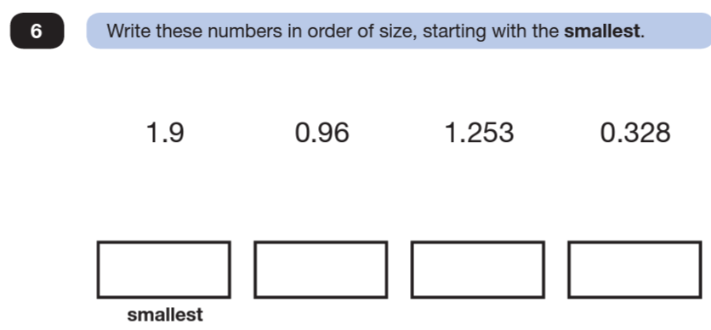
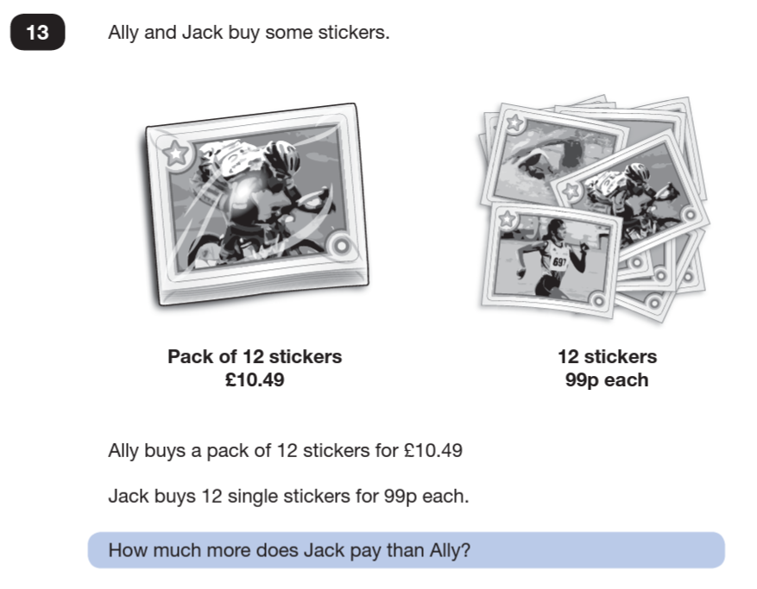
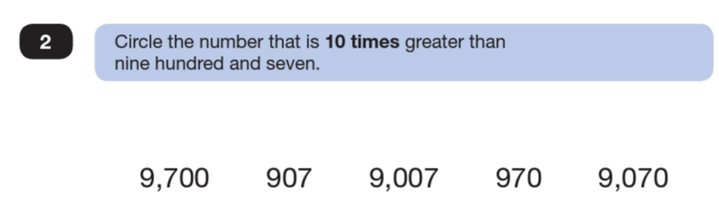

Slide 12
School results in the end of key stage assessments will be published in performance tables.
School results will be shared with the school, their local authority or academy trust and Ofsted to support school improvement.
Results will begin to be returned to schools in July.
Each child will receive a scaled score for their performance on the tests. This is a score between 80 and 120, where a score of 100 is considered to be average or working at the expected level of attainment at the end of primary school.
We will share pupils’ results in their end of year overview, which is sent home to parents in July.

Slide 13
SATs week
Mon 11th May – Spelling, Punctuation & Grammar
Tues 12th May – Reading
Wed 13th May – Maths Arithmetic & Reasoning 1
Thurs 14th May – Maths Reasoning 2
Scripts are sealed and sent away to be marked externally.

Slide 14
How can I help my child?
Ensure your child is having enough sleep (try and remove any devices an hour before bedtime otherwise the brain becomes overstimulated making it harder to sleep).
Attend each day and on time.
Nutritious breakfast.
Encourage homework completion. The homework is in the style of a SATs paper (homework club available to all on a Tuesday evening and staff are available to support).
Alleviate any concerns or worries.
SATs are a snapshot of your child’s academic results. They have so many more capabilities, gifts and talents. Although we want them to achieve their potential – they do not define them.

Slide 15

Breakfast
Y6 are invited into school at 8.15am from Monday 11th - Friday 15th May.
School provide a free, nutritious breakfast with plenty of choice (hot and cold)
This allows us to settle the children, greet them with a smile and calm any nerves ahead of the tests.
We will also provide the children with some ‘Top Tips’ before they begin their assessments; therefore, it is so important that children are on time during this week as tests cannot be delayed and we want them feeling confident and ready.

Slide 16
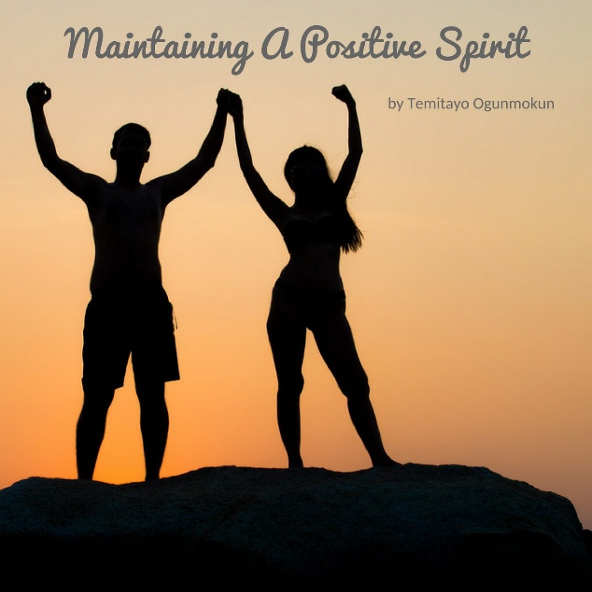
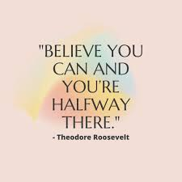
Year 6 SATs Song 2026 We’ve got spirit, yes, we do! We’ve got spirit, how about you? What we gonna do? What we gonna do? Cheer…Year…6!
Created by Year 6 Pupils
This will be sung every morning before the children begin their ‘Top Tips’ and assessments to give them a positive energy, increase self-belief and a confident spirit ☺

Slide 17
Feel free to peek at some past papers and ask staff any questions ☺

